Slide 1
Regression

Slide 2
Regression
Definition : A statistical technique for estimating the relationship between two or more variables.
The estimated relationship is represented in the form of an equation. The general form of regression equation is as follows:
Y = β₀ + β₁X + ε
Where,
X = Independent variable that used to predict the dependent variable (also called predictor variable)
Y = Dependent variable being predicted by regression model (also called response variable)
β₀ & β₁ are called regression parameters and interpreted as
  β₀ = Intercept (The average value of dependent variable Y when independent variable X is zero)
  β₁ = Slope (The change in dependent variable Y for the unit change in independent variable X)
  ε = Residual (error), the portion of the dependent variable that is not explained by the model.

Slide 3
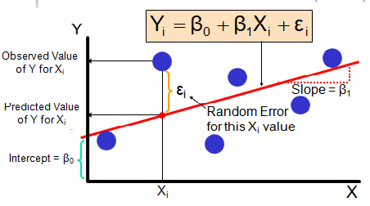
Regression : Explanation

Slide 4
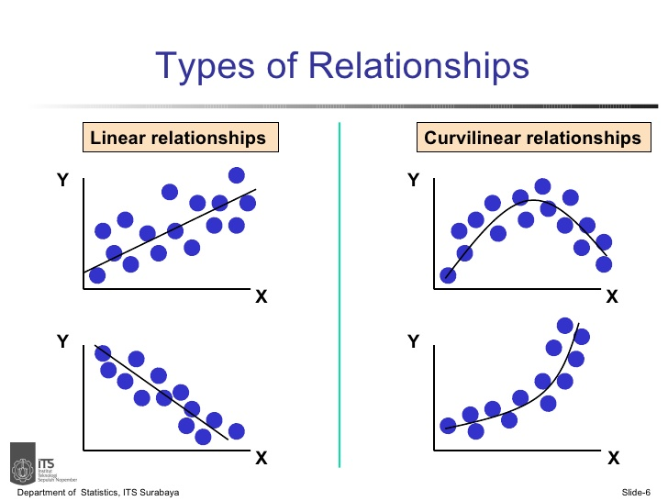
Linear Vs Nonlinear

Slide 5
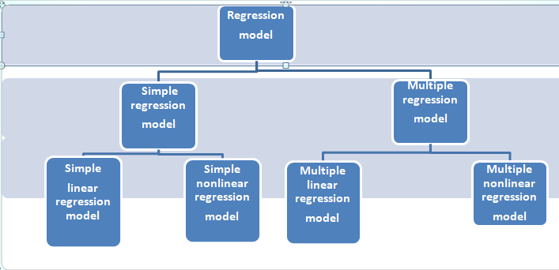
Regression : Model types
Only1 predictor variable
2 & more predictor variables
Model is a linear equation
Model is a nonlinear equation
Model is a nonlinear equation
Model is a linear equation

Slide 6
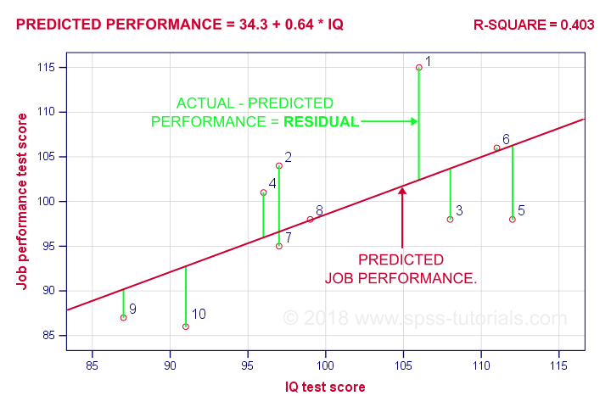
Regression : General Methodology
General Steps for Regression analysis :
Exploring the relationship by plotting the independent variable with dependent variable.
Specify the Regression model. (Simple linear, multiple linear or Nonlinear)
Estimate the regression parameters with minimum residual(error).
Analyze the relationship & predict the dependent variable for future.
Example:

Slide 7
Regression : some common models
Simple linear Regression: To predict the sales using the expenditure on advertisement.
Multiple linear Regression: To predict the compressive strength of cement using the contents of cement.
Logistic Regression: To predict that a customer will take loan or not based on the factors such as age, gender, income, marital status etc.

Slide 8
Linear Regression

Slide 9
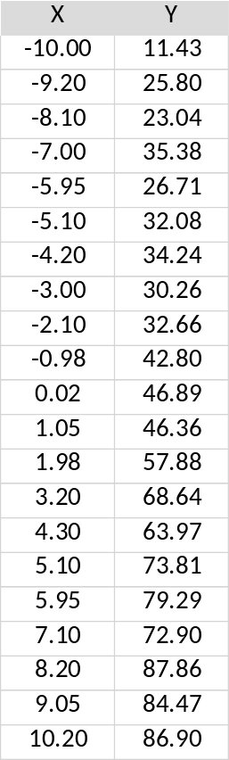

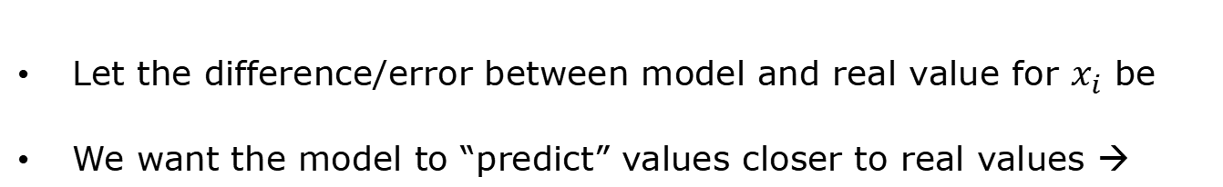



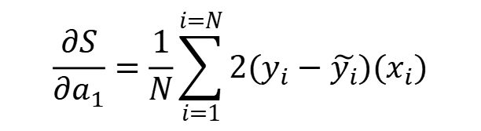
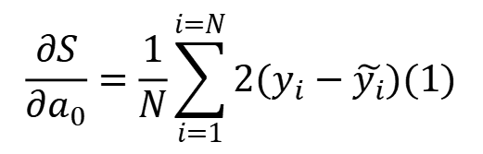
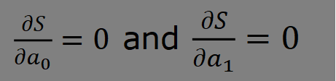
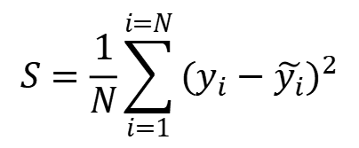
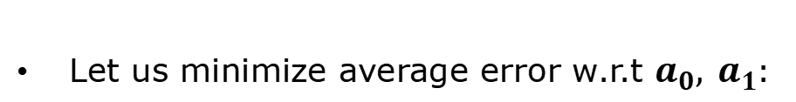
Linear Regression - Univariate
y
Data set
$N=21 \left(x,y\right)$ pairs
Variable
Expression for linear regression:
$$\tilde{y}=a_{0}+a_{1}x$$
Parameters
x
$$a_{0}, a_{1}$$
What is the “best” value of that predicts the data?
Method
Let the difference/error between model and real value for $x_{i}$ be
We want the model to “predict” values closer to real values →
$$∆_{i}=y_{i}−\tilde{y_{i}}$$
$$∆ should be as small as possible for any x$$
Let us minimize average error w.r.t $a_{0}, a_{1}:$
$$S=\frac{1}{N}\sum_{i=1}^{i=N}{{(y}_{i}−\tilde{y_{i}})^{2}}$$
$\frac{∂S}{∂a_{0}}=0$ and $\frac{∂S}{∂a_{1}}=0$
$$\frac{∂S}{∂a_{0}}=\frac{1}{N}\sum_{i=1}^{i=N}{2(y_{i}−\tilde{y_{i}})(1)}$$
$$\frac{∂S}{∂a_{1}}=\frac{1}{N}\sum_{i=1}^{i=N}{2(y_{i}−\tilde{y_{i}})(x_{i})}$$
Contd.

Slide 10
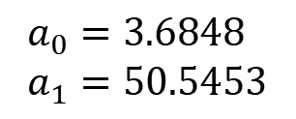
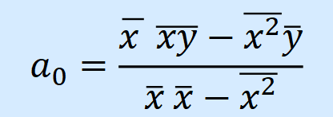
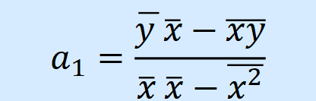



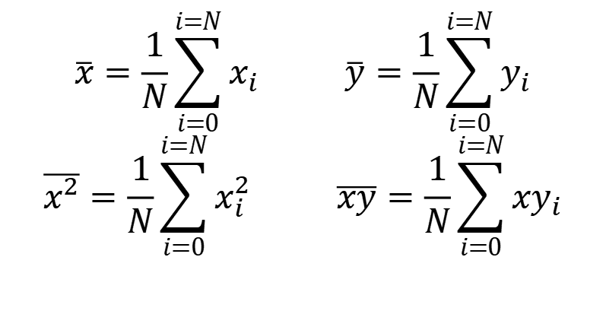
Linear Regression - Univariate
$$\overline{x}=\frac{1}{N}\sum_{i=0}^{i=N}{x_{i}} \overline{y}=\frac{1}{N}\sum_{i=0}^{i=N}{y_{i}}$$
$$\overline{x^{2}}=\frac{1}{N}\sum_{i=0}^{i=N}{x_{i}^{2}} \overline{xy}=\frac{1}{N}\sum_{i=0}^{i=N}{xy_{i}}$$
Leads to two simultaneous algebraic equations in
$a_{0}+{\overline{x } a}_{1}=\overline{y}$
$$a_{0}, a_{1}$$
$${\overline{x}a}_{0}+{\overline{x^{2}} a}_{1}=\overline{xy}$$
Can be solved easily to get “best”
$$a_{0}, a_{1}$$
Exercise 1: Show that
$$a_{0}=\frac{\overline{x } \overline{xy}−\overline{x^{2}}\overline{y}}{\overline{x} \overline{x}−\overline{x^{2}}}$$
$$a_{1}=\frac{\overline{y }\overline{x}−\overline{xy}}{\overline{x} \overline{x}−\overline{x^{2}}}$$
Exercise 2: For the dataset, calculate parameters and show that
$$a_{0}=3.6848 \\ a_{1}=50.5453$$
Exercise 3: use Excel “trendline” method to validate that this is correct.

Slide 11

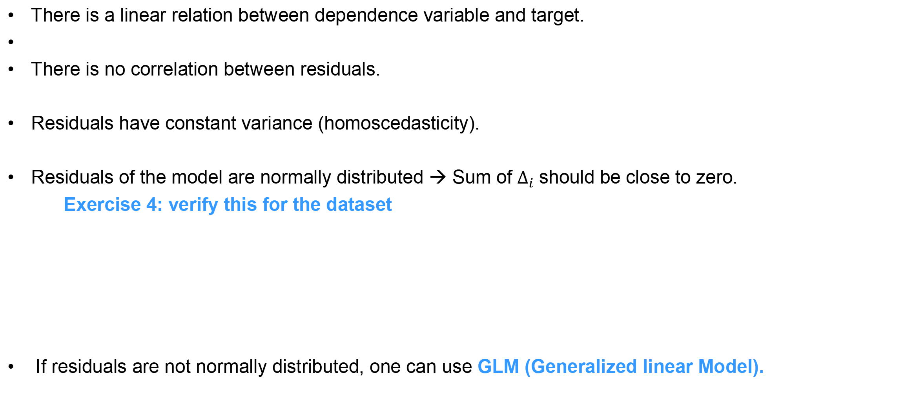
Assumptions of linear regression
There is a linear relation between dependence variable and target.
There is no correlation between residuals.
Residuals have constant variance (homoscedasticity).
Residuals of the model are normally distributed → Sum of $∆_{i}$ should be close to zero.
  Exercise 4: verify this for the dataset
If residuals are not normally distributed, one can use GLM (Generalized linear Model).

Slide 12
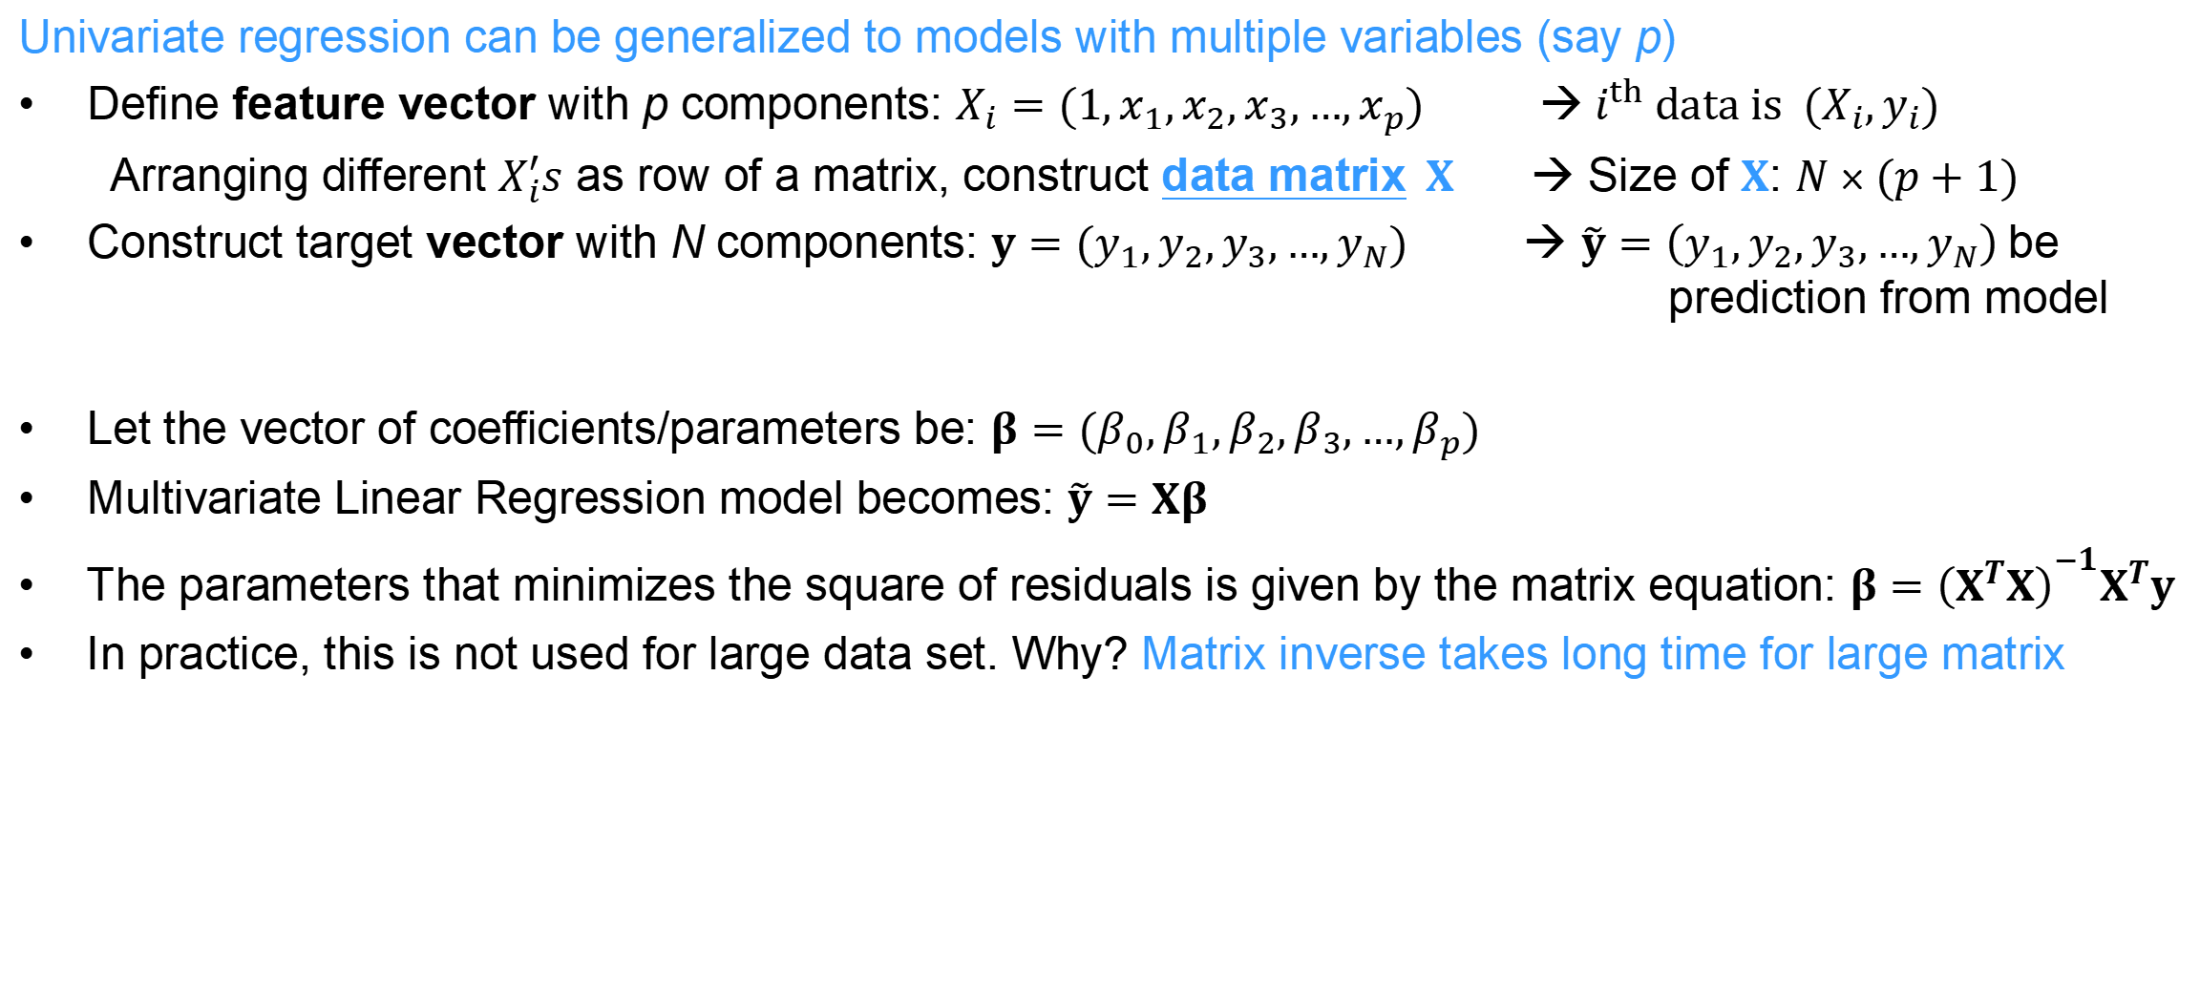
Linear Regression - Multivariate
Univariate regression can be generalized to models with multiple variables (say p)
Define feature vector with p components: $X_{i}=(1,x_{1},x_{2},x_{3},…,x_{p})$ →${{ i}^{th} data is (X}_{i},y_{i})$
  Arranging different $X_{i}^{′}s$ as row of a matrix, construct data matrix$X$ → Size of $X$: $N×(p+1)$
Construct target vector with N components: $y=(y_{1},y_{2},y_{3},…,y_{N})$ → $\tilde{y}=\left(y_{1},y_{2},y_{3},…,y_{N}\right)$be prediction from model
Let the vector of coefficients/parameters be: $β=(β_{0},β_{1},β_{2},β_{3},…,β_{p})$
Multivariate Linear Regression model becomes: $\tilde{y}=Xβ$
The parameters that minimizes the square of residuals is given by the matrix equation: $β={\left(X^{T}X\right)}^{−1}X^{T}y$
In practice, this is not used for large data set. Why? Matrix inverse takes long time for large matrix

Slide 13
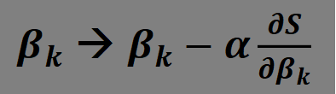
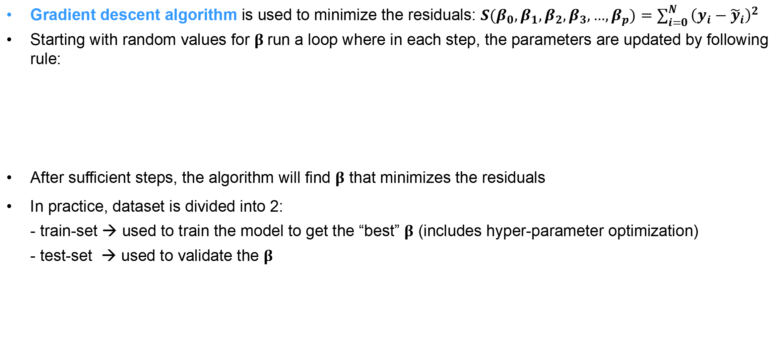
Linear Regression - Multivariate
Gradient descent algorithm is used to minimize the residuals: $S(β_{0},β_{1},β_{2},β_{3},…,β_{p})=\sum_{i=0}^{N}{{\left(y_{i}−{\tilde{y}}_{i}\right)}^{2}}$
Starting with random values for $β$run a loop where in each step, the parameters are updated by following rule:
After sufficient steps, the algorithm will find $β$ that minimizes the residuals
In practice, dataset is divided into 2:
- train-set → used to train the model to get the “best” $β$ (includes hyper-parameter optimization)
- test-set → used to validate the $β$
$β_{k}$ → $β_{k}−α\frac{∂S}{∂β_{k}}$
“Learning rate” – adjusted to get best performance from algorith

Slide 14
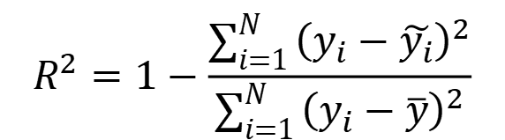
Linear Regression – Model Quality
How does one measure the quality of the model?
Model Accuracy
  Calculate root mean square error (RMSE) on test data:
  Measures the model accuracy against new data / unseen data
  Calculate R2 score:
  Measures how much variation in target variable is predicted by dependent variable
Model Robustness
Measure of the sensitivity of the model to (outlier) data (and violation of regression assumption)
M-statistics
Ability to explain
Model that is easily explainable is preferred over complicated models
model with fewer parameters are more stable, less sensitive to data distribution, robust
$$R^{2}=1−\frac{\sum_{i=1}^{N}{{\left(y_{i}−\tilde{y_{i}}\right)}^{2}}}{\sum_{i=1}^{N}{{\left(y_{i}−\overline{y}\right)}^{2}}}$$

Slide 15
THANK YOU FOR YOUR
ATTENTION

